Slide 1

WEB DEVELOPMENT
Rishi Gupta​

Slide 2
Contents
1
2
3
4
5
Introduction to Web Development
Front-End Development
HTML, CSS and JavaScript – An Overview
Welcome to React.js
Summary

Slide 3





Introduction
It refers to developing the website for Internet.
It is used to create dynamic Web Applications.
Examples of Web Applications are social networking sites like Facebook or E-commerce sites like Amazon, flipkart etc.
There are 2 broad division of Web Development –
Front-End Development (also called Client-side development)
Back-End Development (also called Server-side development)

Slide 4

Why become Front-end Developer
You’ll be in high demand.
You can work anywhere in the world.
You’ll never be bored.
You can work on variety of Projects.
You can make a good salary.
You don’t need a college degree.
You can start quickly
You can work independently or on a team
You can make a difference
You can have a lot of fun

Slide 5

Front-End Development
It refers to producing a web application so that a user can see and interact with them directly.
It includes designing and coding the layout, visual elements, and interactivity of the site.
The common technologies we can use in Front-end Development are:
HTML
CSS
JavaScript

Slide 6

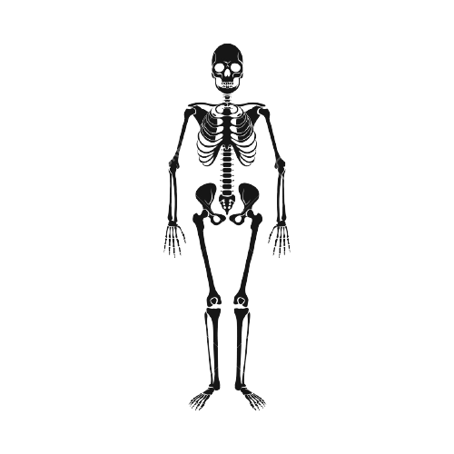
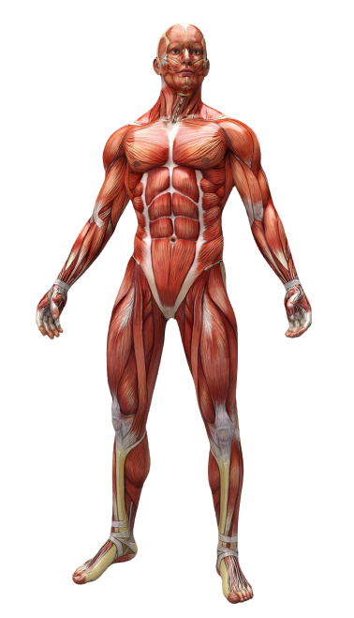

HTML, CSS and JavaScript – An Overview
HTML
Hypertext Markup Language
Structure of Page
JavaScript
Interactivity with User
Dynamic Updates in web page
CSS
Cascading Style Sheets
Presentation/Styling

Slide 7

React Js
React is a JavaScript Library created by Facebook.
React is a declarative, efficient, and flexible JavaScript library for building user interfaces.
React allows us to create reusable UI components.
It lets you compose UIs from small and isolated piece of code called “components”.
React can be used in development of single-page or mobile applications.

Slide 8
How does React work?
It’s used for handling view layer for web and mobile apps.
React creates a VIRTUAL DOM (document object model) in memory.
High Speed in processing.
You can write React in 2 ways:
You can write React code directly in HTML
In order to use React in production, you need NPM and Node.js installed.

Slide 9
Thank you
Rishi Gupta
grishi025@gmail.com

